Slide 1
NINKASI: Beer Recommender
Alex Li, Andrew Wu, Nelson Chen, Luke Chu
Dec 18, 2016
NK

Slide 2
Outline
NK
Introduction
Data scraping
Exploratory data analysis
Recommender system
Content-based method
Collaborative filtering method
Python Flask App
Future improvements

Slide 3
Introduction
NK

Slide 4
Introduction
NK
Build a recommender system for beer lovers!
Recommender can find similar beers based on reviews
Recommender can also give suggestions based on other user explicit ratings
Models tied together in a Flask App

Slide 5
Project Workflow
NK
Data Scraping
Data Preprocessing & EDA
NLP Processing
EDA
Recommender System Algorithm
Content-Based
Collaborative Filter
Flask App

Slide 6
Web Scraping & Data Cleaning
NK

Slide 7
Data Scraping
Scrapy Fields
NK
Beer Information | Beer Review Information
Beer Name | User Name
Brewer Name | User Location
Weighted Average | Time of Review
Beer Image | User Rating
State Beer Produced | Aroma
Overall Score | Appearance
Beer Style | Taste
Alcohol by Volume | Palate
Estimated Calorie | Overall
IBU (Int’l Bitter Unit) | Review
Beer Description
Website: www.ratebeer.com
About 280,000 reviews
Limited data scope to top 20-25 beers per state

Slide 8
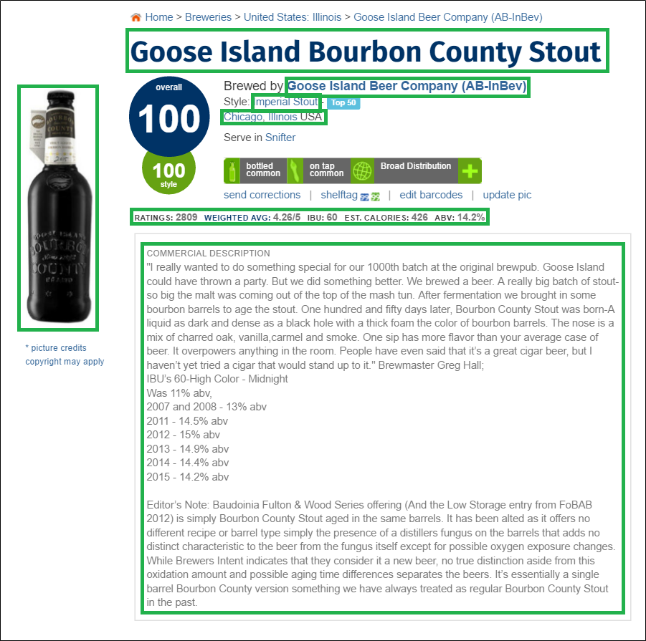
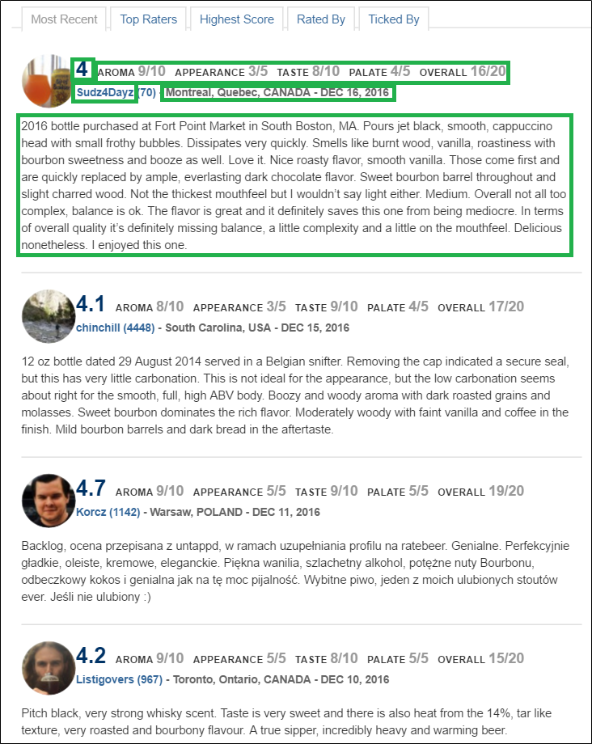
Data Scraping
NK

Slide 9
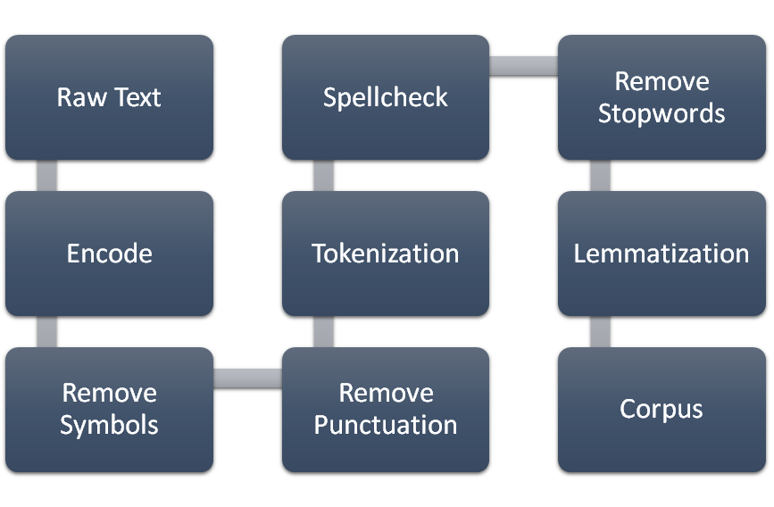
Data Preprocessing
NK

Slide 10
Exploratory Data Analysis
NK

Slide 11
EDA: Beer Items
NK
~1200 beers
58 styles, 335 unique brewers
Weighted Average out of 5.0, Estimated Calories, ABV, Overall Score out of 100, Style Score out of 100, IBU (Many Missing Values)

Slide 12
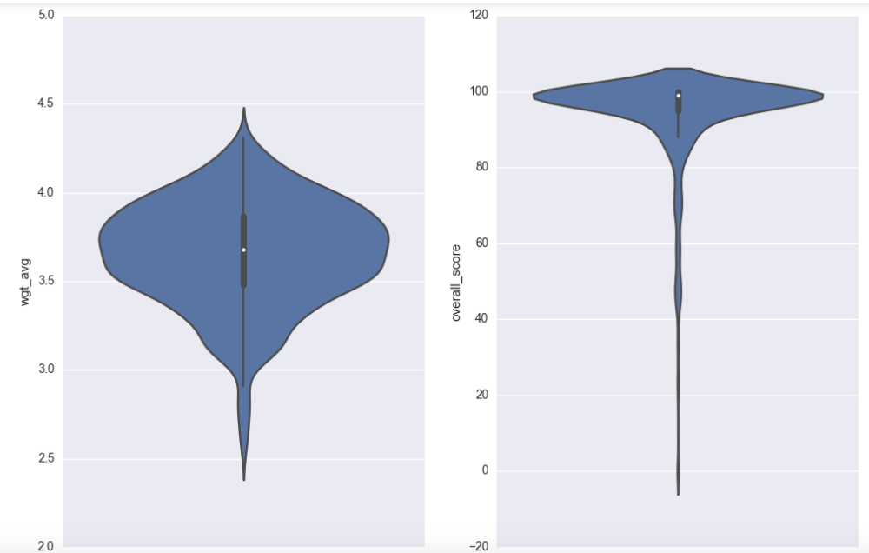
NK

Slide 13
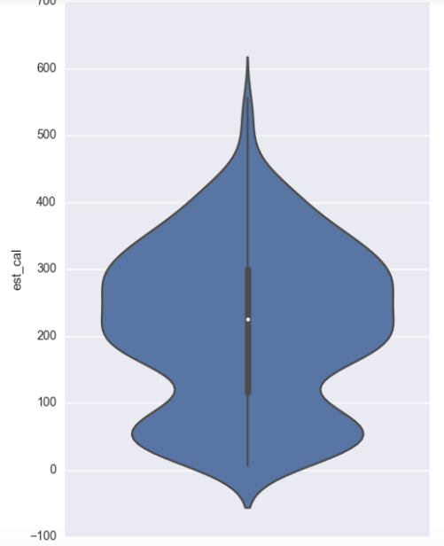
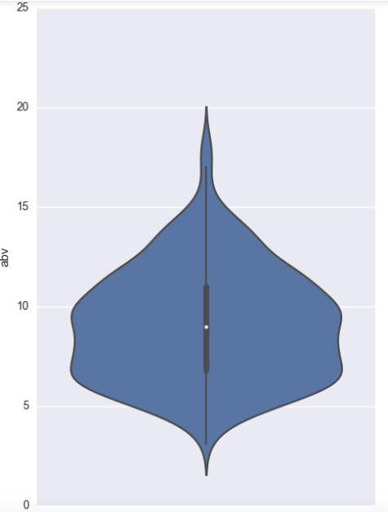
NK

Slide 14
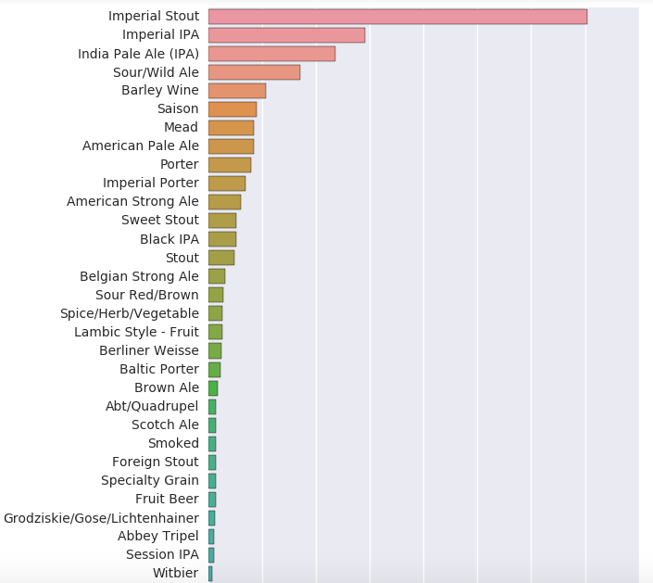
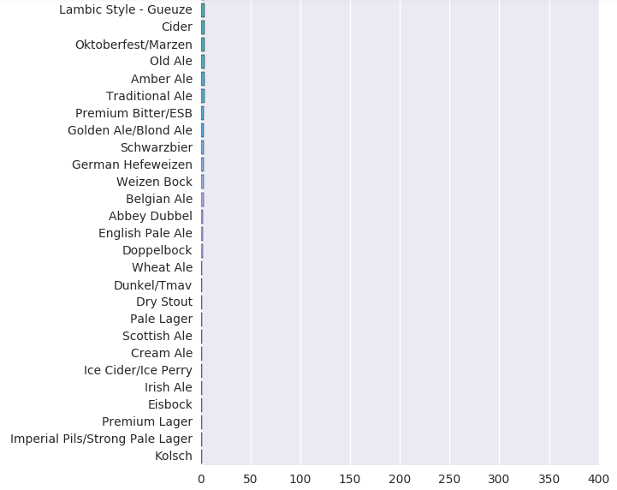
NK

Slide 15
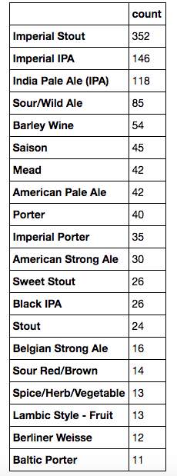
NK

Slide 16
EDA: Reviews
NK
After Cleaning:
~11,370,000 words
approximately the number of words in 150 350-page books
~278,000 reviews
~average of 40 words per review
Average Rating - 16.17/20
~127,600 unique words, only 1.1% of number of words.

Slide 17
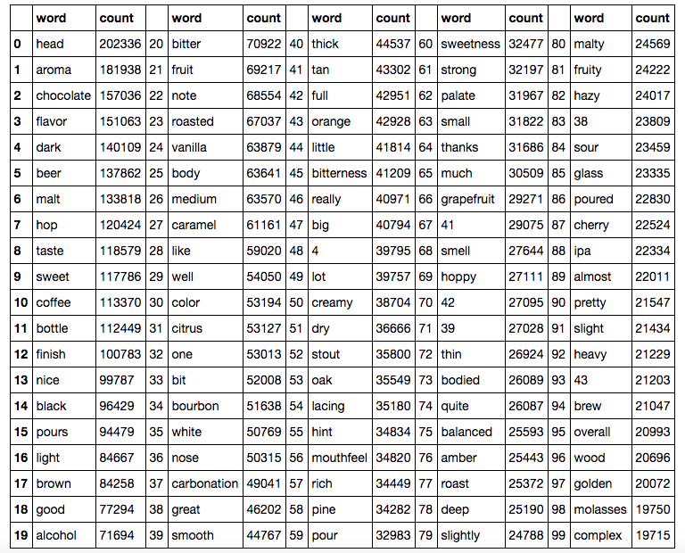
Top 100 Most Frequent Words
NK

Slide 18
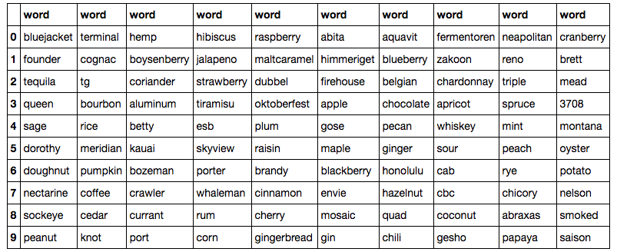
NK
Top 100 TF-IDF words (distinct, no particular order)

Slide 19
NK
Latent Dirichlet Allocation
0.012*"chocolate" + 0.010*"coffee" + 0.009*"bourbon" + 0.006*"black" + 0.006*"roasted" + 0.004*"roast" + 0.004*"brown" + 0.004*"vanilla" + 0.003*"dark" + 0.003*"stout"
0.006*"pine" + 0.006*"citrus" + 0.006*"grapefruit" + 0.005*"orange" + 0.004*"ipa" + 0.004*"tropical" + 0.004*"hop" + 0.004*"golden" + 0.003*"funk" + 0.003*"mango"

Slide 20
Recommender System
NK

Slide 21
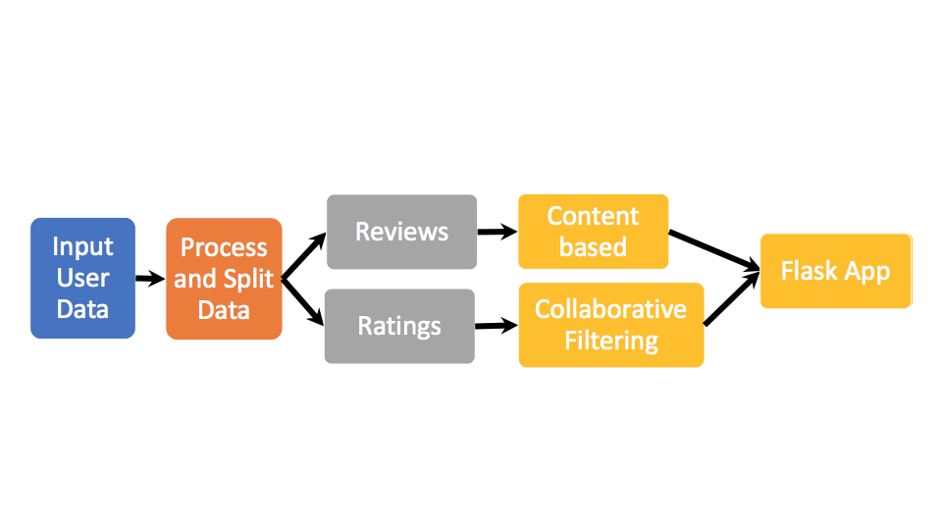
Recommender System
NK

Slide 22
Content-Based Algorithm
NK
Recommendation based on user review.
Two algorithms were implemented:
Term Frequency-Inverse Document Frequency (TF-IDF) to produce the document-term matrix
Latent Semantic Analysis (LSA) does dimension reduction on the document-term matrix

Slide 23
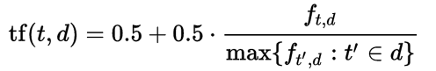


Term Frequency-Inverse Document Frequency (TF-IDF)
NK
Calculate the “importance” of every word to a review in a corpus.
Produce a document-term matrix
Term Frequency is the number of times a word occurs in a document.
Inverse Document Frequency measures how much information each word provides, or how rare is the word across all documents.
The TF-IDF is defined as

Slide 24
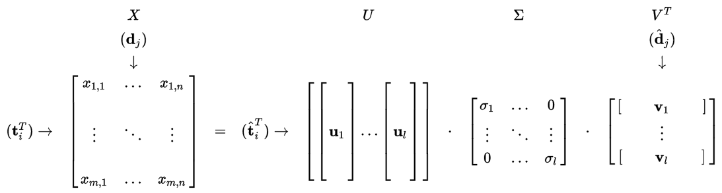
Latent Semantic Analysis (LSA)
NK
Similar to PCA, LSA does dimension reduction by performing SVD on the document-term matrix

Slide 25
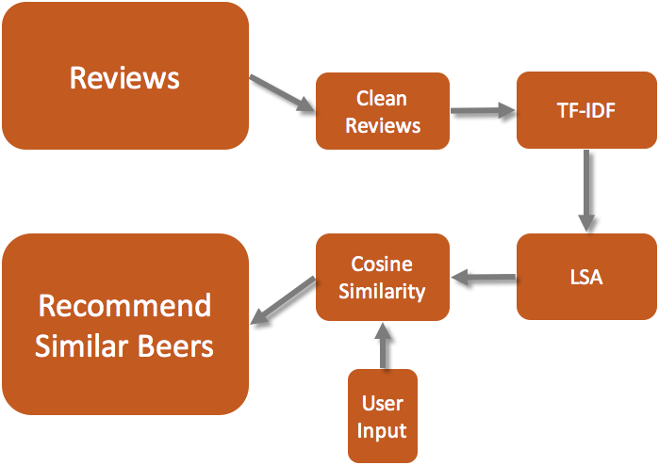
Content-Based Recommender System
NK

Slide 26
Collaborative Filtering
NK
Recommendation based on beer rating (explicit information)
Two separate models were used
Singular Value Decomposition++ (SVD++)
Restricted Boltzmann Machine (RBM)

Slide 27
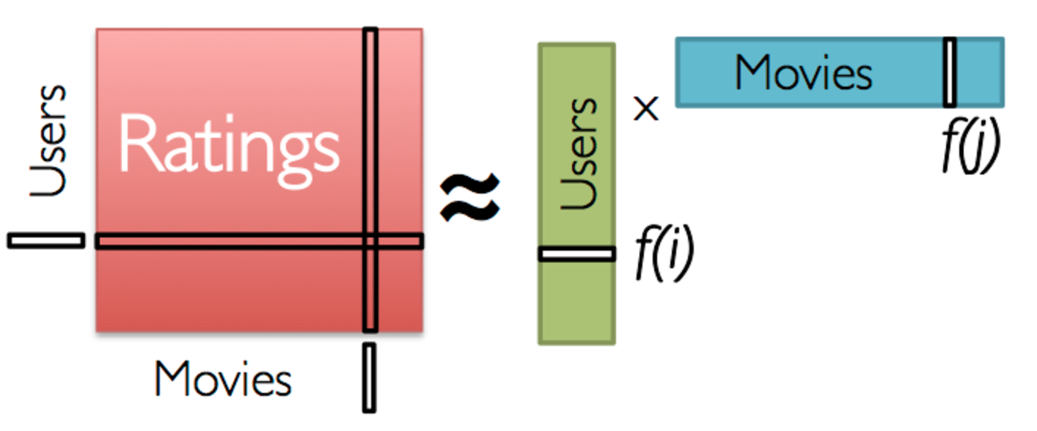
SVD For Collaborative Filtering
NK
Latent Matrix Factorization of user-item matrix to latent features
Used Spark to implement as baseline: RMSE = 2.15
https://databricks-training.s3.amazonaws.com/movie-recommendation-with-mllib.html

Slide 28

SVD++ (Implicit Feedback Version)
NK
Developed by Netflix Challenge winners
Further decompose ratings to global average, user/item biases, implicit feedback, and latent features
Remove bias of each user and item to center data
Users that have less ratings are penalized more (given rating closer to average)
Predicted rating
Global average
User bias
Item bias
Item Latent feature
User latent feature
Implicit feedback
parameters
Implicit feedback

Slide 29
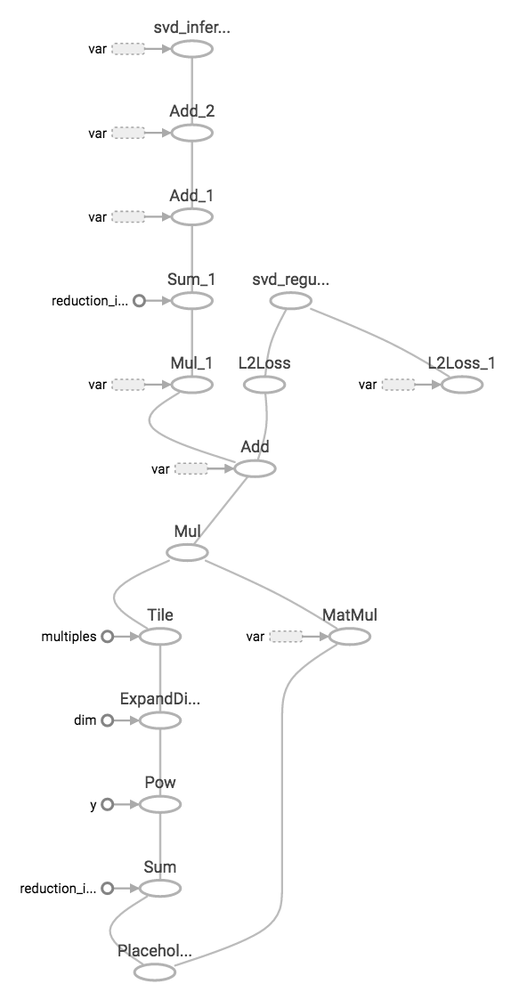
SVD++ Implementation
NK
No fast publicly available package
Realized SVD++ can be highly optimized using TensorFlow
Found vanilla SVD algorithm built in Tensorflow
Augmented code to include biases, implicit feedback, k-fold cross validation, and early stopping
Accelerated by C++ backend, GPU computation
Results: RMSE = 1.69

Slide 30
Restricted Boltzmann Machine (RBM)
NK
RBM is an unsupervised, two-layer neural network
Inspired by the Boltzmann Distribution from thermodynamics and fluid dynamics to minimize the energy function
Performs CF by reconstructing the user-item matrix
Hidden units can be thought of as latent features

Slide 31
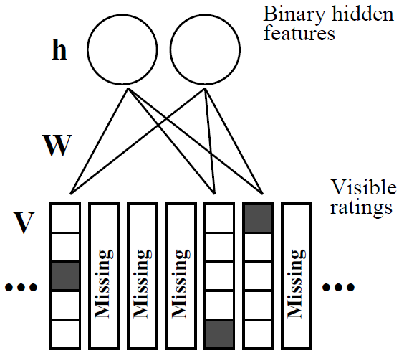
Restricted Boltzmann Machine
NK
To train a RBM:
Initialize the visible layer
Hidden layer is calculated
Missing values are imputed
Weights are updated based with gradient descent
The RBM is trained for every user, but the weights and bias are shared across all users

Slide 32
Ensemble CF models
NK
Averaged SVD++ and RBM predictions to get final predictions

Slide 33
Prediction Method for New Users
NK
Neighborhood approach
Compute cosine similarity between new user and all users
Impute missing ratings of new user by a weighted average proportional to similarity metric
Rank recommendations and output top 5

Slide 34
Flask App Demonstration
NK

Slide 35
Lessons Learned & Future Steps
NK

Slide 36
Lessons Learned
NK
Text is fundamentally messy to work with
When an algorithm is not available, implement it yourself
Hacking other people’s code can be time consuming (RBM), document your code for readability
Workflow is important, also good to document workflow
Don’t try to build Flask app from scratch in two days

Slide 37
Future Steps
NK
Add in more features (i.e style, palate, appearance, aroma, taste, and time)
Add in more data
Tune hyperparameters to get optimal single models
Ensemble smarter (use minimizer or stacking)
Develop App aesthetics and functionalities further

Slide 38
We hope you enjoyed our presentation,
Cheers!
NK

